Slide 1
Lecture assignment
Amir Dirin

Slide 2
Buy Item from an auction
Use Case: Buy Item on Auction
Scope: Auction System
Level: Use Goal
Intention: The intention of the customer is to follow the auction, which may then evolve into an intenton to buy an item by auction, e.g., he / she may then choose to bid for an item.
Multiplicity: Several customers can place bid simultaneously. A given customer may bid in many different auctions at any time.
Primary Actor: Customer
Precondition: The Customer has already identified her/himself to the system

Slide 3
Main Scenario
Customer may leave the auction and come back again later to look at the progress of the auction, without effect on the auction; in this case, the Customer is required to join the auction again.
1. Customer searches for an item under auction.
2. Customer requests System to join the auction of the item.
3. System presents a view of the auction to Customer.
Steps 4-5 can be repeated according to the intentions and bidding policy of the Customer.
4. Customer makes a bid on the item to System.
5. System validates the bid.
6. System closes the auction with a winning bid by Customer

Slide 4
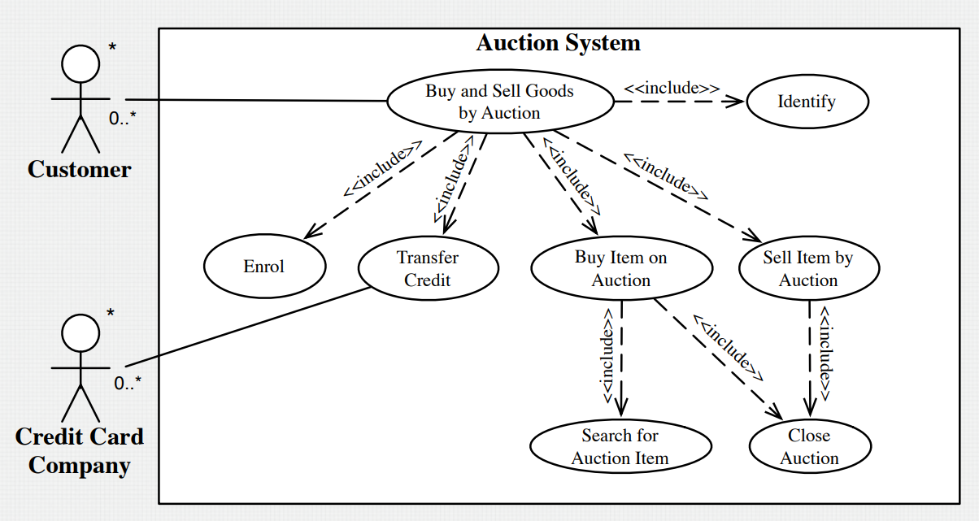

Slide 5
Student Transcript
Use StarUML as a tool to draw the UML use-case diagrams for the following software system. (Grading: 2 points for diagram)
Diagrams may require footnotes and/or comments. Consider the following set of requirements for a university information system that is used to keep track of students transcripts. The first requirement RS1 concerns the data to be kept in permanent storage, which is further broken down into five parts. RS1a. The university keeps track of each student's name, student number, social security number, current address and phone, permanent address and phone, birthdate, sex, class (freshman, sophomore, ..., graduate), major department, minor department (if any), and degree program (B.A., B.S., ..., Ph.D.). Some user applications need to refer to the city, state, and zip of the student's permanent address, and to the students' last name. Both social security number and student number have unique values for each student. RS1b. Each department is described by a name, department code, office number, office phone and college. Both name and code have unique values for each department. RS1c. Each course has a course name, description, code number, number of semester hours, level, and offering department. The value of code number is unique for each course. RS1d. Each section has an instructor, semester, year, course, and section number. The section number distinguishes different sections of the same course that are taught during the same semester/year; its values are 1, 2, 3, ...; up to the number of sections taught during each semester.
RS1e. A grade report has a student, section, and grade.

